Slide 1
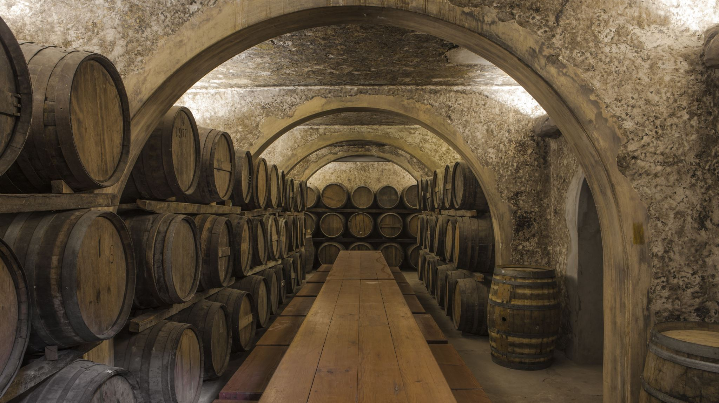
Wine Quality Prediction
BY
AJAY KUMAR REDDY POREDDY
2247259

Slide 2
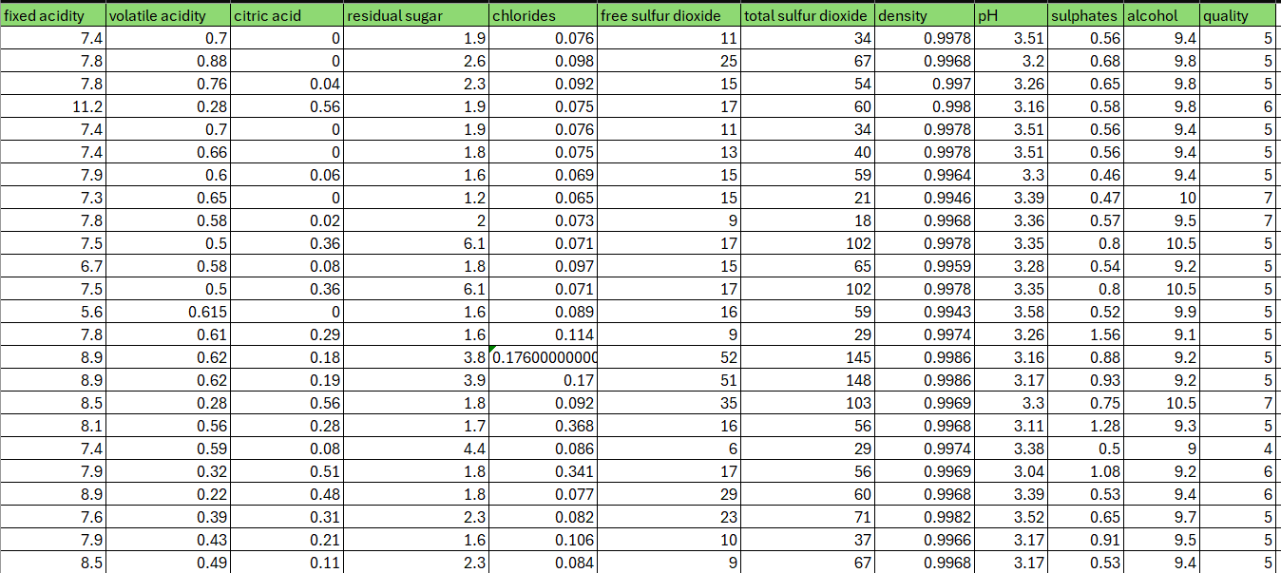
DATASET :The wine quality dataset comprises various physicochemical properties of wines. This dataset provides valuable insights into the relationship between wine composition and perceived quality, offering an opportunity for analysis and predictive modeling.
INTRODUCTION
The response variable (Y) is quality.
The predictor variables (X_{i}) are fixed acidity, volatile acidity, citric acid, residual sugar, chlorides, free sulfur dioxide, total sulfur dioxide, density, pH, sulphates, alcohol.

Slide 3
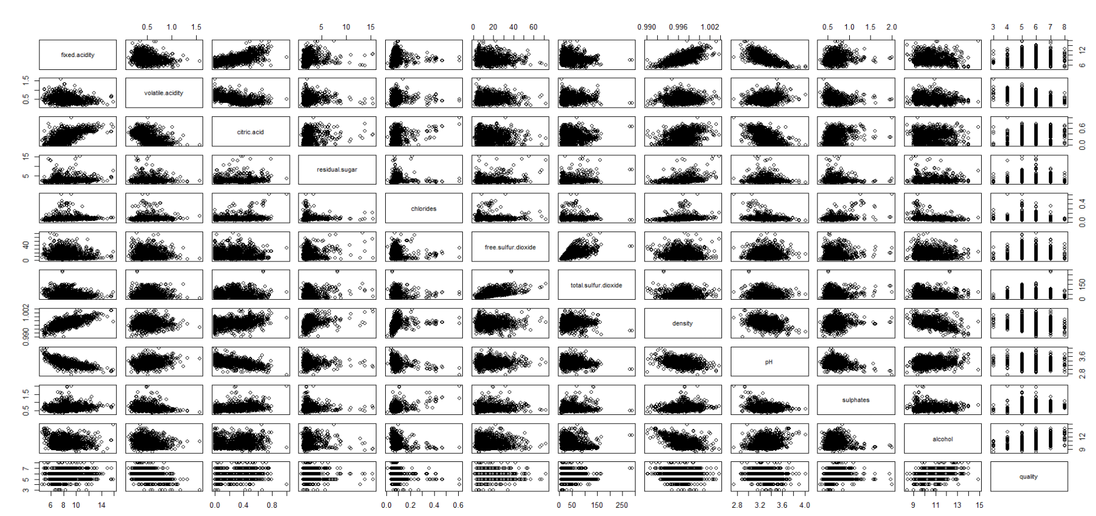
Checking multicollinearity
Fixed.acidicty , Critic acid , PH, density(more)

Slide 4
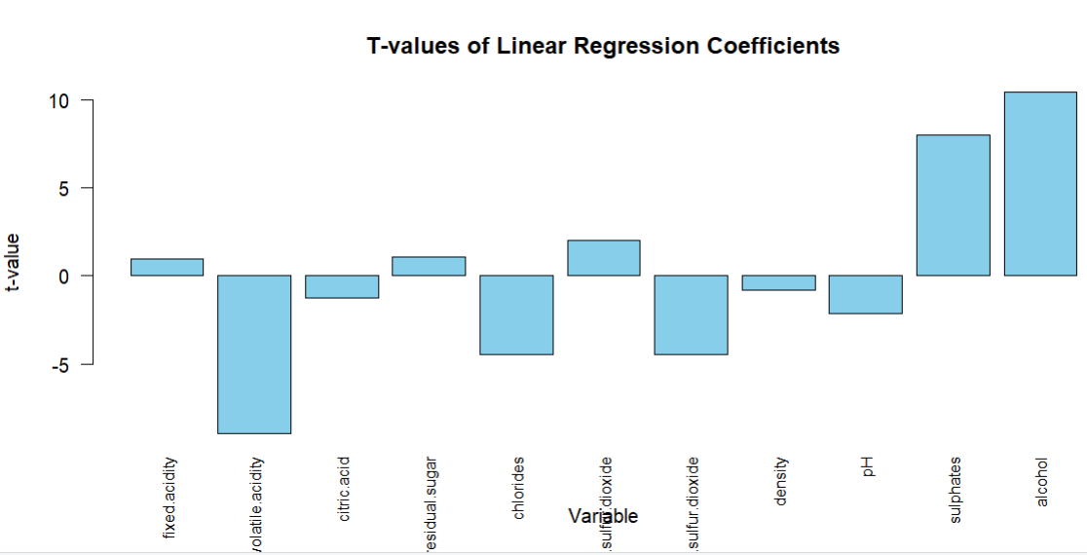
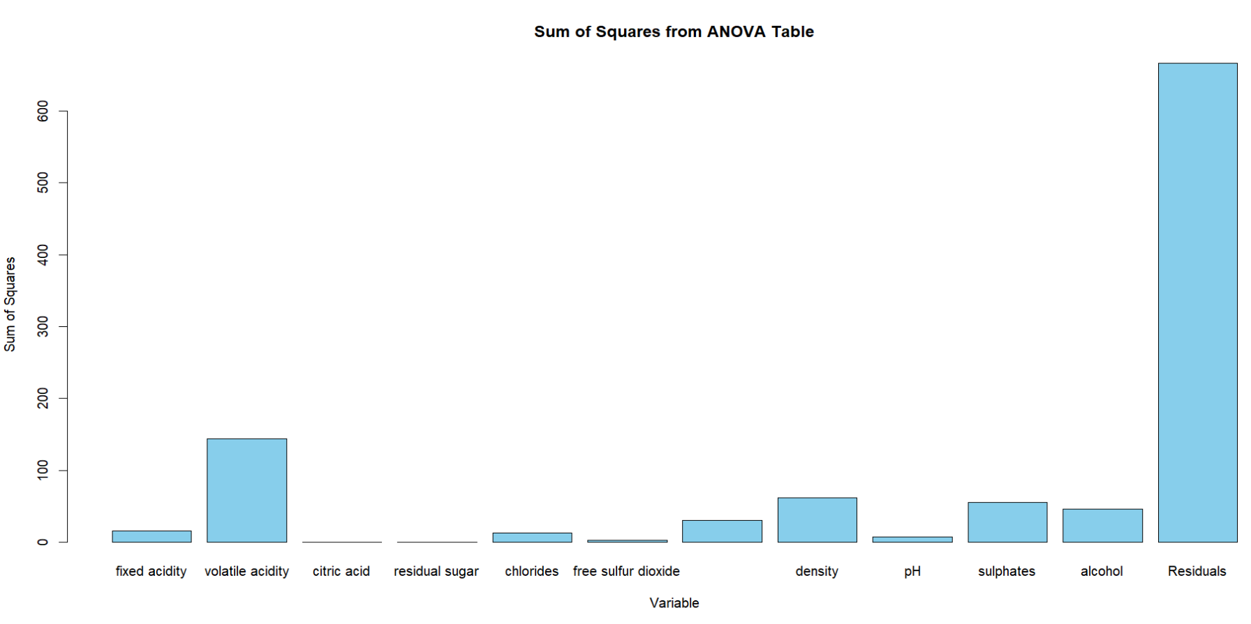



Full Model Y= 21.97 + 0.0249x1 – 1.084x2 – 0.1826x3 + 0.0163x4 – 1.874x5 + 0.00436x6 – 0.00326x7 – 17.88x8 – 0.413x9 + 0.916x10 + 0.276x11
Adjusted R-squared: 0.3561
p-value: < 2.2e-16
t-value high p-value low.
Greater the value of the sum of square the more significance of the variable.

Slide 5
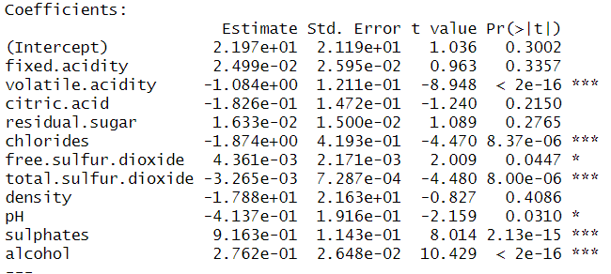
Reduced Model
The p-value variable < 0.05 are insignificant.
Y = 4.430 – 1.012x2 -2.017x5 + 0.005x6 – 0.003x7 – 0.482x9 + 0.88x10 + 0.289x11
Adjusted R-squared: 0.3567
p-value: < 2.2e-16
The Adjusted R-squared is sightly increased.

Slide 6
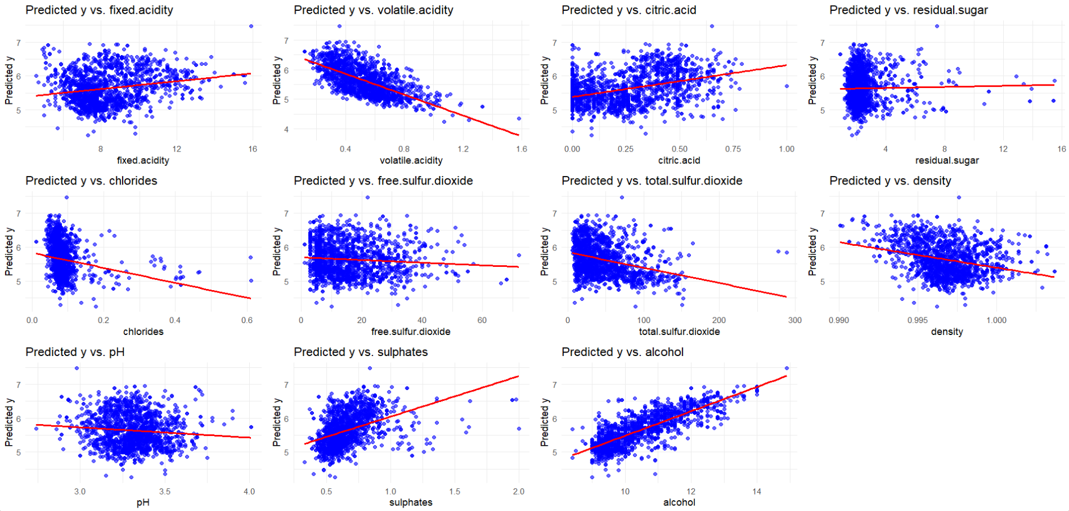
Y-hat $vs xi$ for estimating polynomial degree of $xi$
Checking for any polynomials ( no curve exists, so no exists of polynomial)
Volatile acidity and alcohol are high correlated with the y-hat.
There is no correlation for the residual sugar .
Therefore, we can drop the residual sugar.

Slide 7
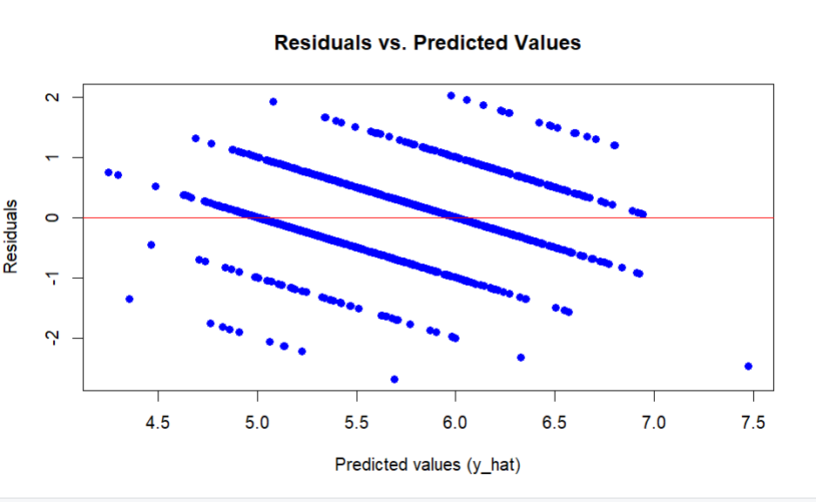
Residuals vs Y-hat
It is heteroscedasticity as it seems like a double bow shape.

Slide 8
1st Transformation
We applied y’ = ln(y) (log)
Transformed model:
Y’= 1.110 + 0.001x1 – 0.213x2 – 0.043x3 – 0.335x5 + 0.0008x6 – 0.0005x7 + 0.451x8 – 0.095x9 + 0.153x10 + 0.050x11
Adjusted R-squared: 0.3372
p-value: < 2.2e-16
Observed that decrease in Adjusted R-squared value

Slide 9
2nd Transformation
Applied y’ = y^-1/2 (reciprocal square root)
Transformed model:
Y’ = 0.682 – 0.0001x1 + 0.0479x2 +0.0106x3 + 0.0719x5 – 0.000106x6 + 0.000106x7 – 0.234x8 + 0.0215x9 – 0.0321x10 - 0.0105x11
Adjusted R-squared: 0.3232
p-value: < 2.2e-16
The adjusted R-squared is still decreasing.

Slide 10
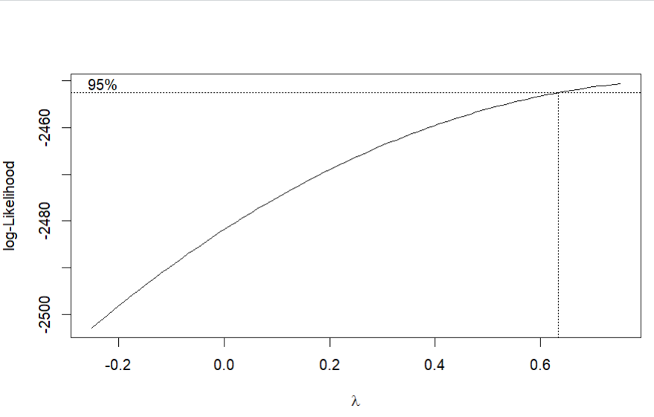
3rd Transformation BOX -COX
Lambda value = 0.62
Adjusted R-squared: 0.3502
p-value: < 2.2e-16
Transformed model:
Y^0.62 = 6.645 + 0.006x1 – 0.361x2 – 0.066x3 + 0.004x4 – 0.601x5 + 0.001x6 – 0.001x7 – 40168x8 – 0.142x9 + 0.289x10 + 0.088x11
The Adj R-squared is less compared to full model but it is better than the 1st and 2nd transformations.

Slide 11
CONCLUSION
Initially tried with the full model, Adj R-squared = 0.3561.
Then, I tried to improve the model by forming the reduced model, first transformation (y’ = ln(y)),
2nd transformation (y’ = y^-1/2) and the 3rd transformation (BOX-COX).
Compared the values of the Adj R-squared value among different methods.
Observed that the 1st , 2nd transformations are decreasing the adj R-squared values and even though the 3rd transformation is better than the other two transformations, but it is also decreasing .
Finally, only the Reduced model Adj R-squared = 0.3567 is slightly increased than the full model.
The factors that influence the quality of the wine are volatile acidity, chlorides, free sulfur dioxide, total sulfur dioxide, density, sulfates, and alcohol.

Slide 12

THANK YOU

